Slide 1
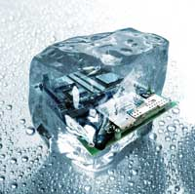
Design pattern Introduction
Hoa Vo
Quan Tran
2015.09.26

Slide 2
Problems
Problems when developing software
Readable
Maintainable
Scalable
Testable
…

Slide 3
OOP concepts
OOP concepts: Abstract class, interface, inheritance, polymorphism … use for ??

Slide 4
Content
What is this

Slide 5
What
Solutions to common problems
Make the code
Reusable
Maintainable
Scalable
Testable

Slide 6
Type
Creational
Behavioral
Structural

Slide 7
Creational
Abstract Factory
Factory Method
Prototype
Builder
Singleton

Slide 8
Structural
Adapter
Composite
Bridge
Decorator
Facade
Flyweight
Proxy

Slide 9
Behavioral
Chain of Resp.
Command
Interpreter
Iterator
Observer
Strategy
…

Slide 10
Practice
DoJo

Slide 11

Question & Answer
Any questions ?

Slide 12




Thank for your attention
www.sioux.asia
+84 (0) 5113888756
contact@sioux.asia

